Slide 1



Data Analysis on Customer Churn for Banking Services
- Abhinav Mishra

Slide 2

About the Project
My Team
Chesapeake Annual Hackathon at UMBC sponsored by M&T Bank 2023
8 hours, 24 Teams
Topic: Data Analysis on Customer Churn for Banking Services
Winner – 1st Prize

Slide 3
About the Dataset
RowNumber: This is the index for each record in the dataset CustomerId: A unique identifier for each customer. Surname: The last name of the customer. CreditScore: The credit score of the customer, which is a numerical measure of their creditworthiness. Geography: The country or region where the customer is located (e.g., France, Spain, Germany). Gender: The gender of the customer (e.g., Male or Female). Age: The age of the customer. Tenure: The number of years the customer has been with the bank. Balance: The account balance of the customer. NumOfProducts: The number of bank products the customer is using (e.g., savings accounts, loans, etc.). HasCrCard: Whether the customer has a credit card (1 for yes, 0 for no). IsActiveMember: Whether the customer is an active member (1 for yes, 0 for no). EstimatedSalary: The estimated annual salary of the customer. Exited: It indicates whether the customer has churned or not (1 for churned, 0 for not churned).

Slide 4
Executive Summary
France has the highest number of bank customers, followed by Germany and Spain. However, the churn rate is highest in Germany (32.44%), followed by Spain (16.67%) and France (16.15%).
Female customers have a higher churn rate, contributing to 55.92% of total churn, compared to male customers who contribute 44.08%
The 41-50 age group has the highest churn (30.51%), followed by the 31-40 (20.84%) and 51-60 (17.35%) groups.
Churn rates are higher for customers with a credit card (69.89%) compared to those without (30.11%)
Most customers with lower credit scores (501-600: 25.21%, 601-700: 36.99%) have higher churn, while churn decreases significantly for scores above 700, indicating better retention among high credit score customers.
Customers with balances in the 100,001-250,000 range have the highest churn (59.94%), while churn decreases significantly for balances below 100,000 and above 250,000, suggesting a middle-range balance may be linked to higher churn risk.
Churn is significantly higher among customers with only 1 product (70.62%), while it decreases as the number of products increases, suggesting higher product engagement reduces churn risk.
Churn is significantly higher among inactive members (63.92%) compared to active members (36.08%), indicating that customer activity strongly influences retention.
Churn is highest during the first year of tenure (12.68%), gradually stabilizing over time, with minor fluctuations, indicating that retaining new customers is critical for reducing churn.

Slide 5
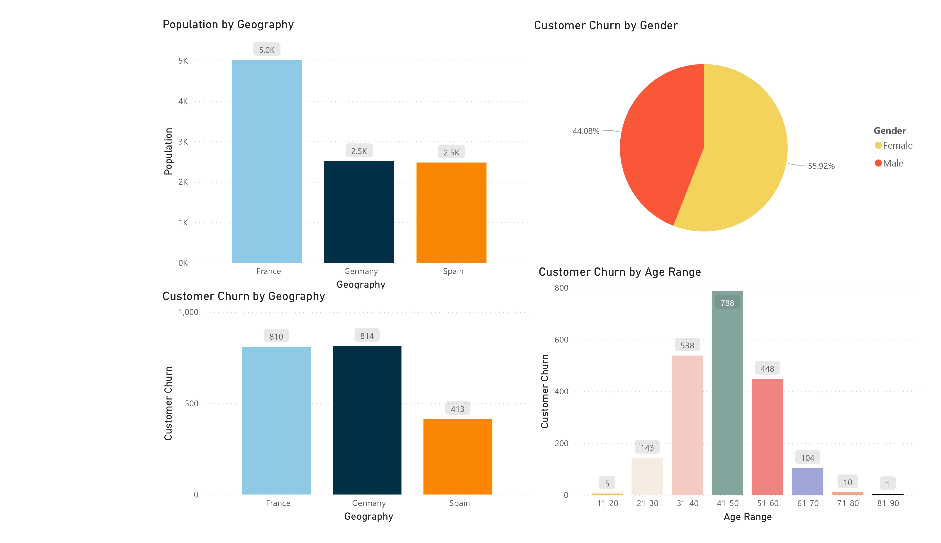
Demographic Churn Analysis

Slide 6
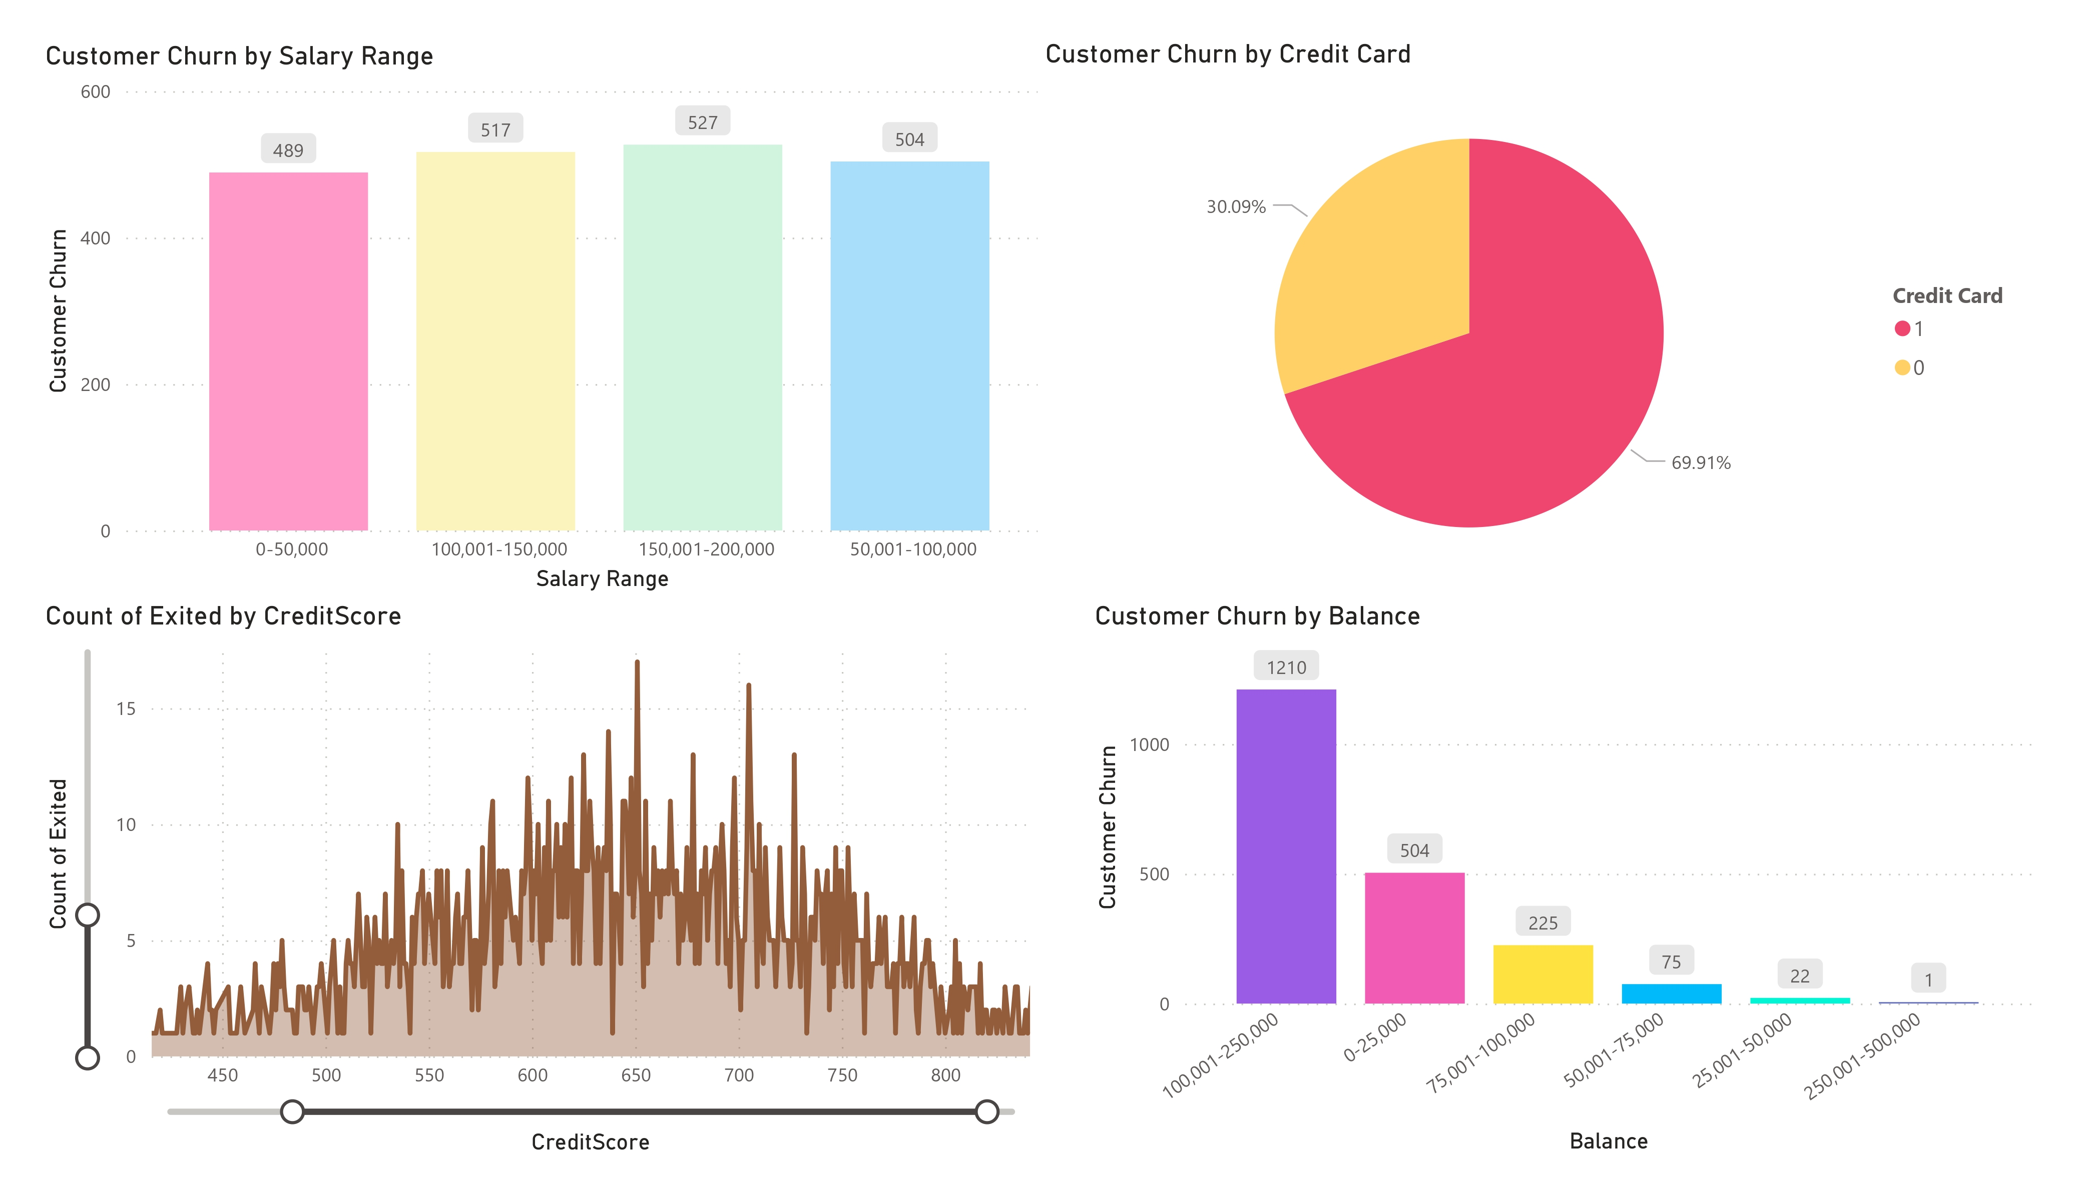
Financial Metrics

Slide 7
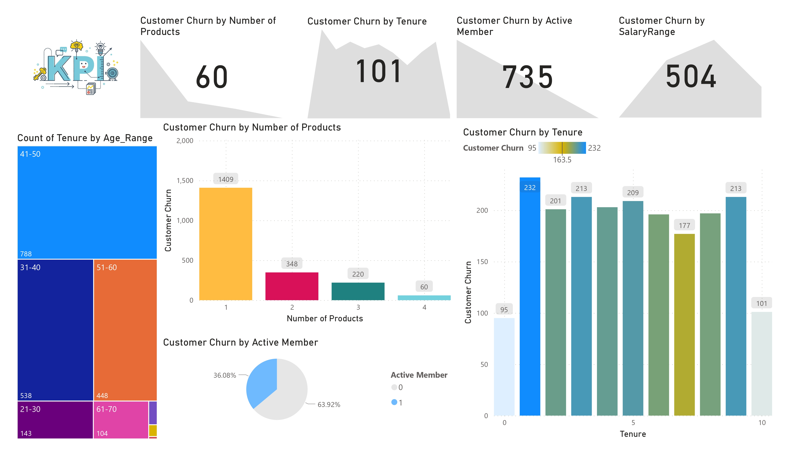
Impact of Credit and Balance/KPIs

Slide 8

Thank You

